Slide 1

Monthly Sales Data Report
Submitted by :- Aniket Katiyar (Data Analyst)

Slide 2
Agenda Purpose
Today, we will explore a comprehensive analysis of our e-commerce sales data. Our presentation will be structured as follows, allowing us to delve into key aspects of our e-commerce performance and insights:-
Data Overview: We'll start by providing an overview of the data sources and collection methods, ensuring a solid understanding of the foundation for our analysis.
Sales Trends: We'll dive into the sales data, examining trends, seasonality, and any noteworthy patterns that have emerged over time
Product Analysis: We'll analyze product performance, identifying top-performing and underperforming products, along with their impact on overall sales.
Recommendations: We'll conclude by providing actionable recommendations based on our findings, aiming to optimize our e-commerce strategy.

Slide 3
Presentation Overview
"Good Afternoon, Sir. Thank you for joining us today. I’m Aniket Katiyar, and I'm delighted to be here to present our analysis of e-commerce sales data.
In today's data-driven world, understanding and leveraging e-commerce data is crucial for making informed business decisions. Our objective with this presentation is to delve into the depths of our e-commerce sales data to uncover insights that will drive our strategy forward.
Throughout the presentation, we'll explore the significance of our findings and offer recommendations for optimizing our e-commerce strategy. By the end, you'll have a clearer understanding of our e-commerce performance and the steps we can take to further our success.

Slide 4
Introduction to product analysis
In this section, we will turn our focus to the performance of our products within our e-commerce catalog. Understanding how each product contributes to our sales and profitability is essential for strategic decision-making. We'll examine key performance metrics, identify top-performing and underperforming products, and discuss strategies to optimize our product offerings.
Let's dive into the data and uncover valuable insights that will help us make informed decisions about our product lineup.

Slide 5
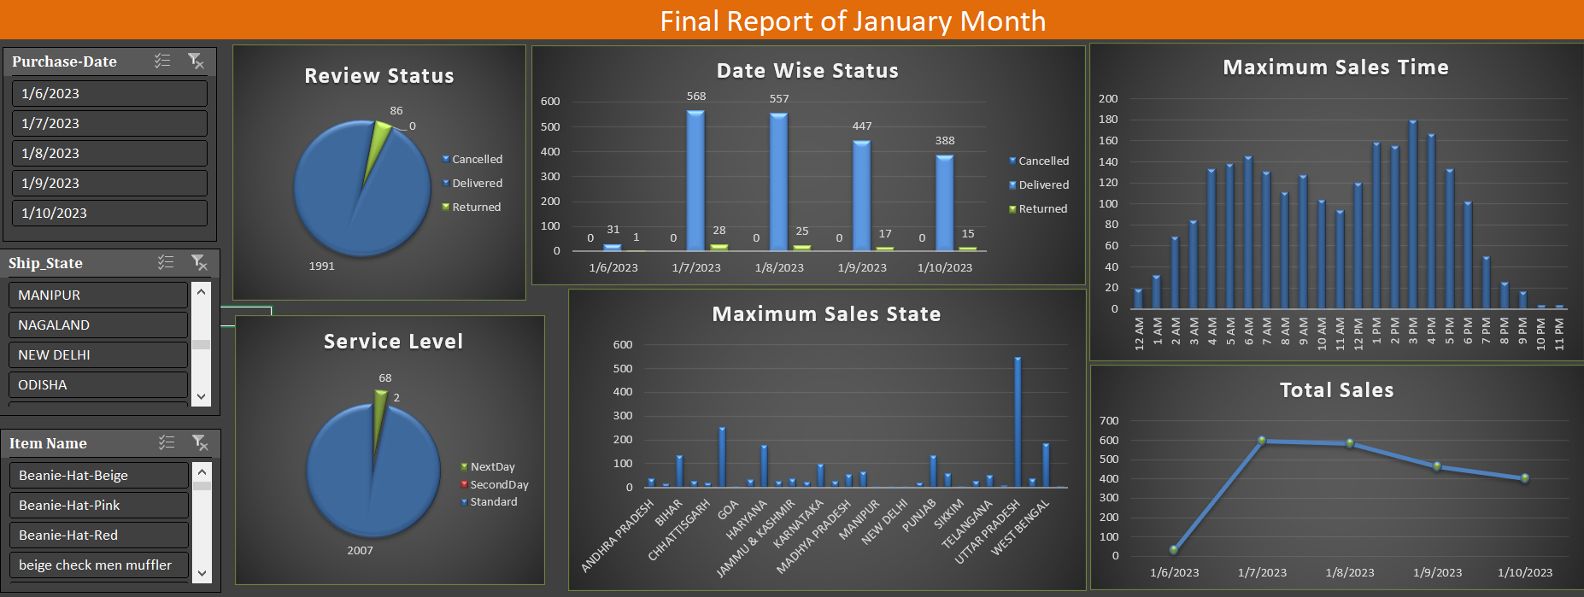

Slide 6
Summary of Sales Data
"In conclusion, our analysis of e-commerce sales data has provided us with valuable insights into various aspects of our business. We've identified top-selling products, pinpointed the states with the highest sales, evaluated service level performance, and recognized peak sales times and dates.
These insights are instrumental in guiding our strategic decisions. For example, we can now allocate resources more effectively, tailor marketing efforts to peak times, and optimize our product offerings. It's clear that data-driven decision-making is at the heart of our future success in the e-commerce industry.
As we move forward, let's ensure that we continue to leverage data analysis to inform our strategies and improve our overall e-commerce performance. Thank you for your attention, and I invite you all to collaborate in turning these insights into actionable steps for our business's growth and success."

